Slide 1
Machine Learning Methods for Antibody Optimization
Emily Makowski
November 18, 2020
Pharmaceutical Sciences 3rd Year Seminar
Notes:
Hi everyone. Thanks for coming to my talk. Today I’ll be speaking on one of my research projects involving machine learning methods for antibody optimization.

Slide 2
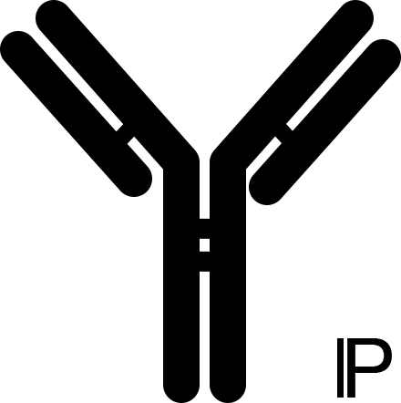
Antibody Discovery
Synthetic Library Maturation
Notes:
In the last thirty years that antibodies have become intensely studied therapeutics one of the methods that has developed for antibody discovery and development is synthetic library maturation during which millions of antibody variants, with small differences in their amino acid residue composition, shown here by the slight variation in binding region shape, are screened in high throughout manners for various properties to isolate a smaller number of candidates that has desired properties. This method is theoretically more controllable and flexible to particular desires and is the method of antibody discovery that the Tessier lab works with primarily

Slide 3
Antibody Optimization
Efficacy
Affinity
Specificity
Immunogenicity
Pharmacokinetics
Developability
Solubility
Thermal Stability
Chemical Stability
Aggregation
Self-interaction
Many of these properties are inversely related
Notes:
Once antibodies have been discovered this process is often employed to aide in the optimization required to further refine the biophysical properties of the proteins and make them suitable to use as therapeutic molecules. These properties impact both the efficacy and developability of the antibody as a therapeutic. Here I have listed some properties that need to be analyzed and optimized.
However, this process is monumentally complicated by the fact that many of these properties are inversely related; exhibiting strict trade-offs that make optimization very difficult sometimes impossible with our current experimental and computational methods.

Slide 4
Antibody Optimization
Efficacy
Affinity
Specificity
Immunogenicity
Pharmacokinetics
Developability
Solubility
Thermal Stability
Chemical Stability
Aggregation
Self-interaction
Many of these properties are inversely related
Notes:
For example, affinity and specificity are two properties that heavily impact the efficacy of an antibody therapeutic. To be effective, an antibody must bind tightly to a target and needs to be specific to that target and not be sequestered by albumin or lost to off-target associations with tissue or extra-cellular matrix components.

Slide 5
Antibody Property Tradeoffs
Binding Interaction
Affinity
Specificity
Charged
Hydrophobic
Flexible
Notes:
With these two properties, it’s relatively easy to see the tradeoff as they both describe the tendency and strength of binding. Binding can result from many physicochemical attributes such as charge, hydrophobicity, and flexibility of the antibody. And what we often see if that as you increase the charged nature of an antigen binding interaction, you risk interacting non-specifically with off-target proteins throughout the body, reducing specificity. This is likewise repeated with hydrophobicity and flexibility. These tradeoffs make it extremely difficult to mature and optimize antibody candidates, particularly as we only have the experimental capacity to optimize a single property at a time.

Slide 6
Standard Optimization
Notes:
The typical optimization process that our lab and many labs and companies use involves the display of antibody binding regions on the surface of yeast cells. And we exploit advances in molecular biology to display libraries of these antibodies. A library is a set of millions of variants of that antibody, differing by up to around 10 amino acids from the parent antibody. These libraries are used to isolate the best variant that binds or does not bind a target which is then reformatted back into a soluble full-length antibody.

Slide 7
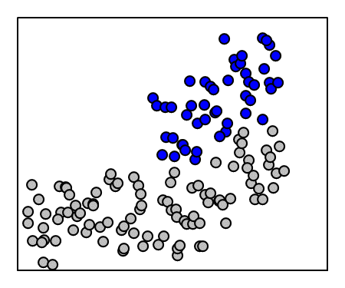
Standard Optimization
Reagent Binding
Antibody Display
Notes:
The isolation process is accomplished via fluorescent activated cell sorting technology, FACS, which allows optimal cells display optimal antibody variants to be collected.

Slide 8
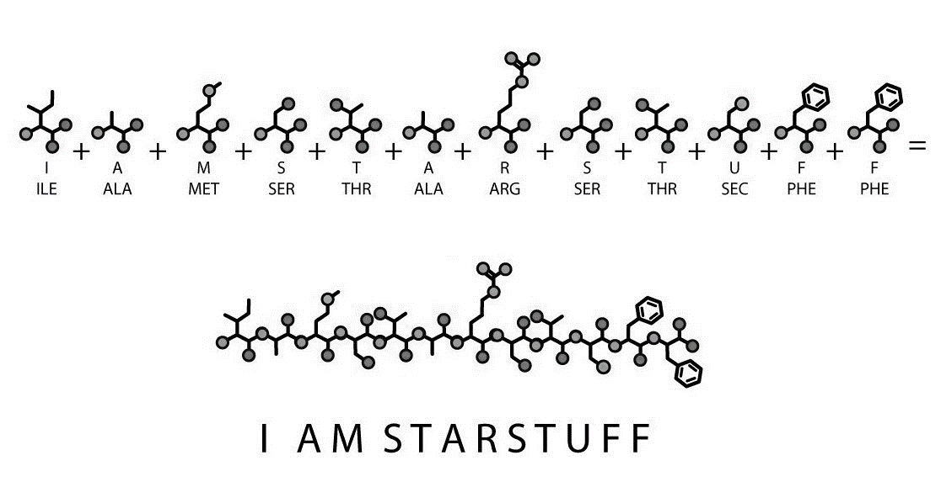
Standard Optimization
Reagent Binding
Antibody Display
Notes:
The collected cells are regrown and their DNA is harvested and sequenced via deep sequencing technology.
So what you end up with is thousands of primary amino acid sequences that generally bind or do not bind the target and these sequences encode for thousands of different antibody variants. But within those thousands options, we have no idea which is the best and we don’t know anything else about its other biophysical properties.

Slide 9
Primary Sequence Data
Enrichment
Ratio
Properties
Affinity
Specificity
Features
Model
Features
Model
Notes:
With primary sequence data, we would optimally like to be able to extract features from the sequence itself, use a model, and predict the properties of that sequence. However, we have yet to be successful at extracting features from sequence data that accurately represent the antibody, which has rich structural information contributing to the properties it exhibits.
In lieu of this success, many have attempted to reconstruct the structural information encoded by the sequence, extract features to model and predict properties. However, the models are massively computationally expensive and the features extracted are not very high quality due to inaccuracies of the models and the inability of human to understand and choose to extract important features.
Subsequently, a proxy measurement of binding referred to as enrichment has been used to infer the true binding properties of a sequence. This enrichment is measured as the increased frequency of a sequence throughout multiple screening processes. However, enrichment has been shown to poorly correlate with binding properties
Where we stand now is unable to use the extensive primary sequence datasets available to predict binding properties of antibodies. We lack a connection from the sequence data to the resulting binding which has been detrimental to our ability to efficiently develop and optimize antibody therapeutics. To address this issue, I am focusing on the central path.

Slide 10
Goal
Properties
Affinity
Specificity
Features
Model
Goal: Use novel feature extraction methods to develop models that can accurately describe, predict, and be used to co-optimize antibody properties
Notes:
Goal is to remove this barrier, using novel feature extraction methods that can be used to accurately describe, predict, and be used to co-optimize antibody properties. And I will accomplish this via machine learning methods

Slide 11
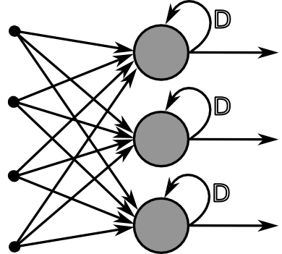
Machine Learning
Model
Recurrent Neural Network
Notes:
And to attempt this, I’ve used machine learning methods. Specifically I’ve used a recurrent neural network. I have chosen neural network because they are very adept at learning and interpreting non-linear data and also have specific capabilities for sequence information interpretation, which is what makes them good for natural language processing and time series evaluation. Long-short term memory enables the persistence of information in the system, shown here by this loop, also known as a forget gate, and this facilitates information learned in the past to be applied later. It’s similar to language as human can remember the subject of a sentence later when the verb is introduced because it becomes important again. The structure of proteins lends itself to this type of analysis as amino acid residues that are far away in the primary sequence may be spatially close and heavily interacting.

Slide 12
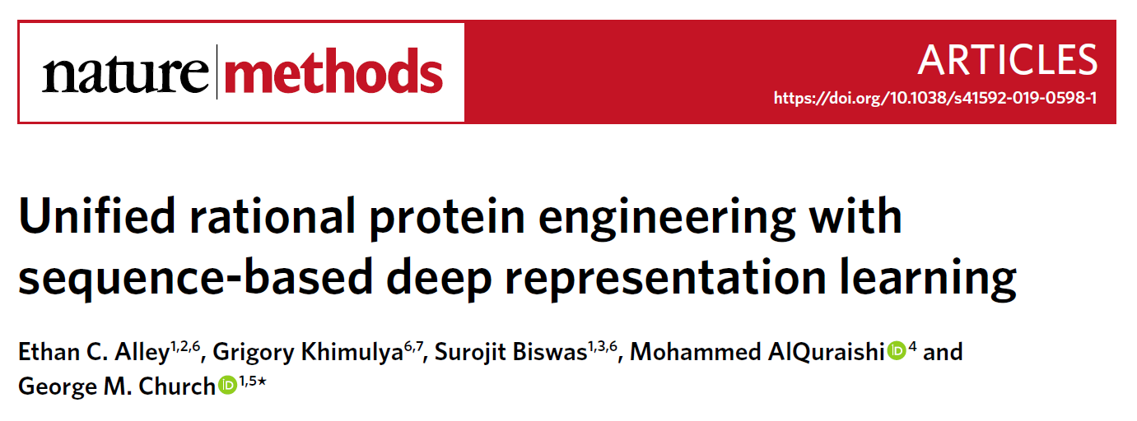
Unified Representation
[G,
A,
W,
V…]
[1.5,
2.7,
4.1…]
Recurrent Neural Network
Notes:
The trained neural network I have used, UniRep, which stands for Unified Representation, was published by the Church group at Harvard. The network is trained on 24 million protein sequences to extract features from the primary amino acid sequences. It works by attempting to predict the next residue in a sequence being fed through, with various correct and incorrect predictions shaping the output. The output is a 64 dimensional numerical feature space that represents a protein sequence, and these representations were shown to distill information about protein structure such as alpha helix or beta sheet structure content.
We are hoping that UniRep can distill information it has learned by learning 24 million protein sequences and provide features that accurately describe affinity and specificity in the place of human feature extraction methods that have failed.

Slide 13

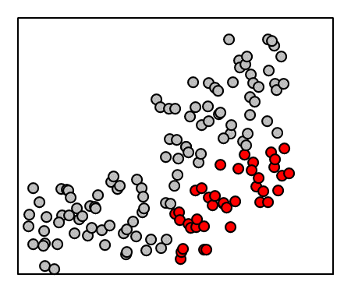
Feature Extraction
Affinity
Reagent Binding
High Affinity?
High Specificity?
Antibody Display
UniRep
Specificity
Reagent Binding
Antibody Display
Sorts performed by Alec Desai and Lina Wu
Notes:
Experimentally, we have taken a parental antibody, made an antibody library sampling several mutations at 8 amino acids. This library was sorted against the parental antibody’s antigen for affinity. For the affinity sort, we collect cells that bind and don’t bind providing two populations that I have used to label the sequences obtained via deep sequencing. The high affinity sequences shown in blue bind to the antigen and are labeled high affinity. We also sorted for specificity. In this case we sort against ovalbumin, which is an off-target reagent and is undesirable to exhibit interactions with. Once again two populations are collected but this time the bottom population is desirable as it is high specificity. I’ve analyzed the sequencing data and found overlapping sequences that can be labeled for both properties, affinity and specificity. These labels come from the populations that the sequences are isolated from. The blue, high affinity populations would be labeled high affinity, the red population would be labeled high specificity. The sequences are then fed into UniRep to extract 64 features per sequence

Slide 14
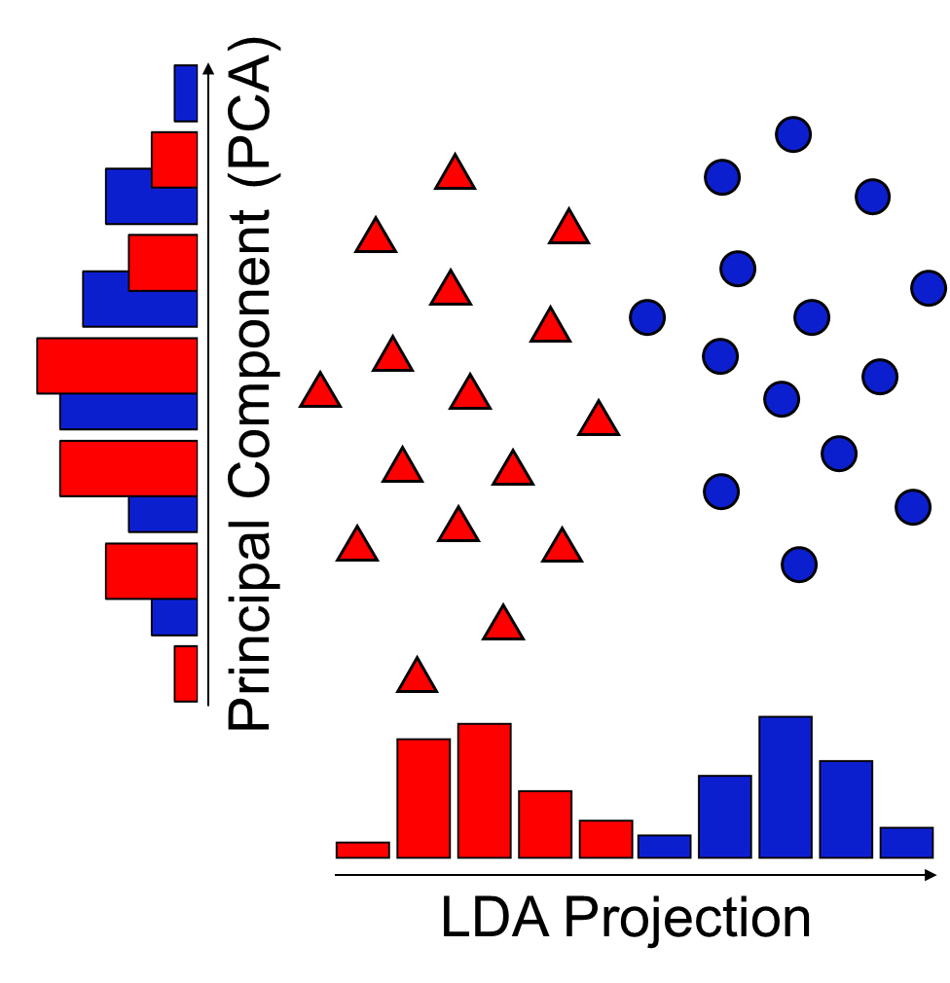
Linear Discriminant Analysis
Supervised Classification
Dimensionality Reduction
Notes:
I’ve then taken linear discriminant analysis or LDA to provide both supervised classification and dimensionality reduction of the features extracted. What LDA does is look for the features or combination of features that best allows discrimination between the labels provided. While something like principal component analysis, on the left axis here, can find the most variance in a dataset and reduce the dimensionality while retaining the most information, it may not be helpful for classification because it may not facilitate the separation of those classes. LDA uses labels to provide the best separation of the classes by reducing the dimensional space of the features to a single projection with a decision boundary cutoff. I performed LDA for both the classification of affinity and the classification of specificity.

Slide 15
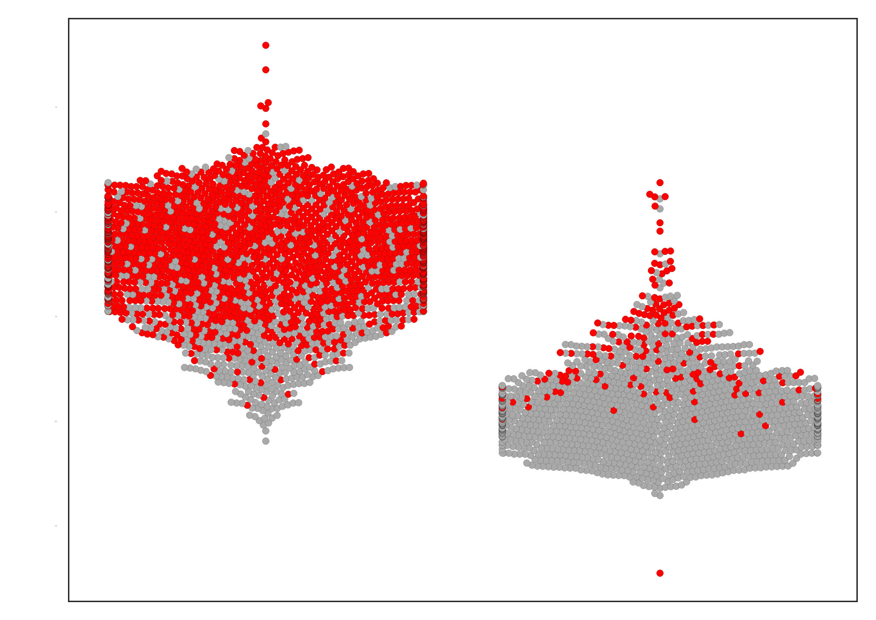
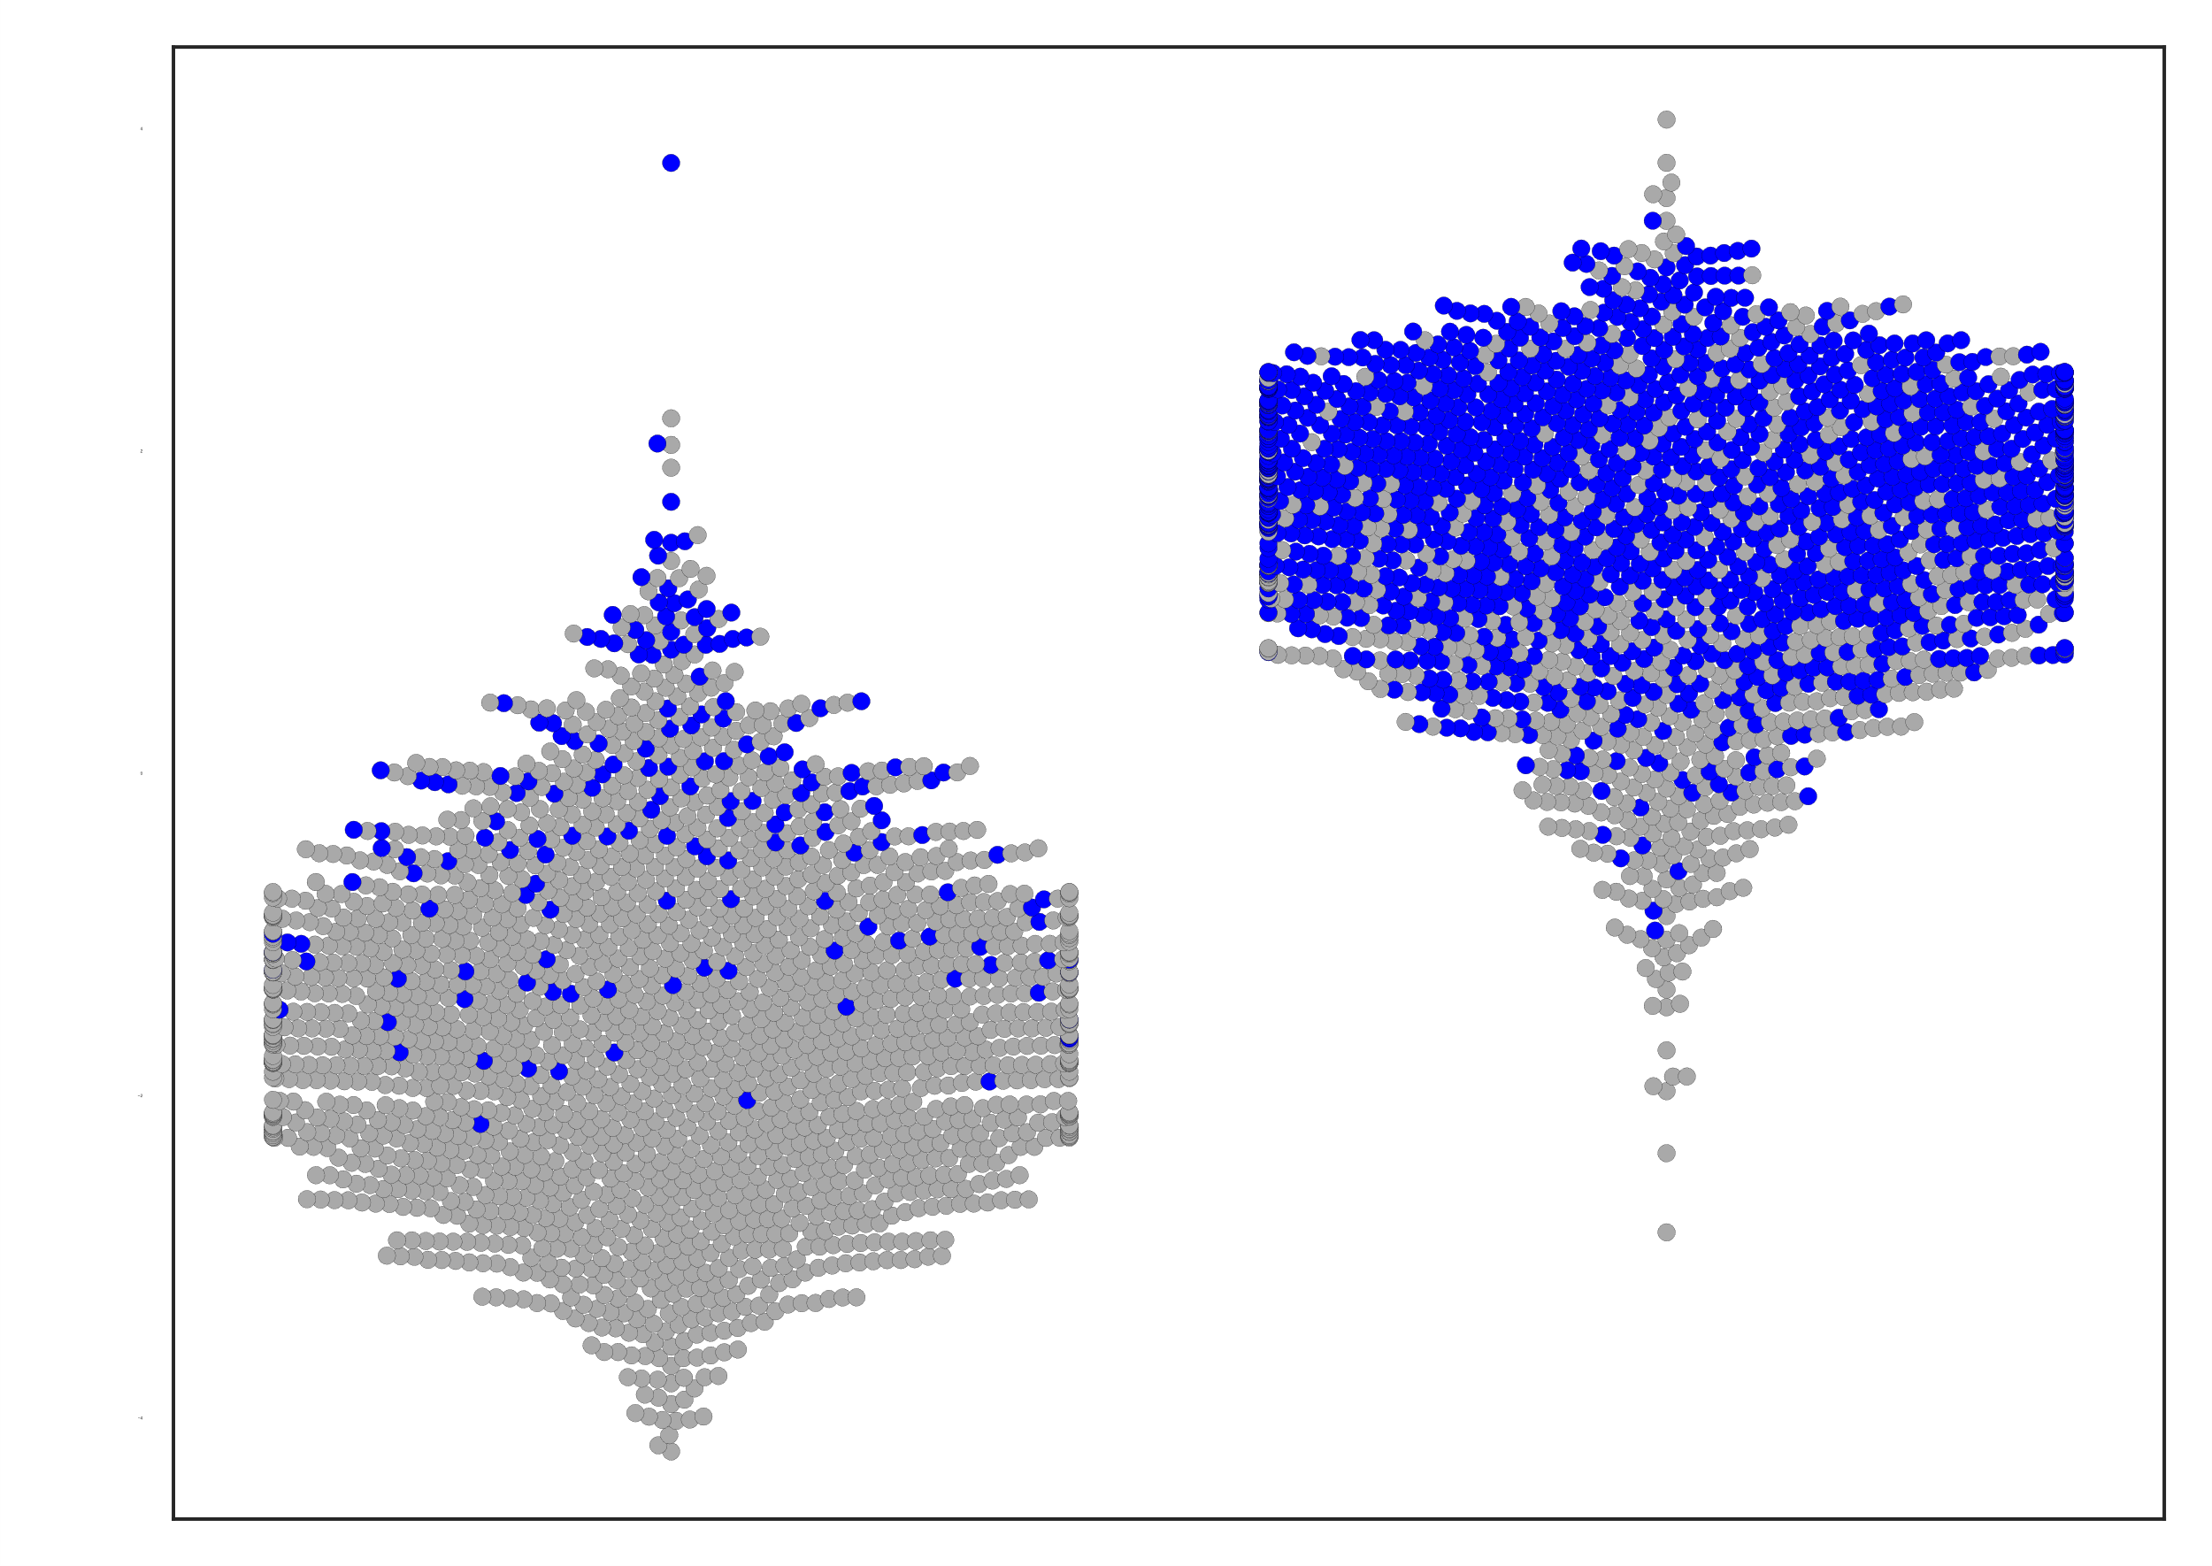
Linear Discriminant Analysis
High Specificity
Low Specificity
High Affinity
Low Affinity
Affinity Projection
Specificity Projection
Low Affinity
High Affinity
High Specificity
Low Specificity
89% accuracy
91% accuracy
Notes:
If we use swarmplots to separate the true classes, the population that the sequence was experimentally sorted into, and plot the affinity projection on the y-axis we can look at the classification accuracy. The black horizontal describes the decision boundary, so everything below that line would be predicted to be high affinity and above the line would be predicted to be low affinity. There are very few sequences on the sides of the line that contradict the experimental population label, and this analysis with 10-fold cross validation results in 89% accuracy. I’ve then colored the datapoints by the opposing property label to further demonstrate the property tradeoffs we are dealing with. On the left, everything below the line is predicted to be high affinity and everything in the right population is experimentally high affinity. Yet almost none of those data points are colored red, or high specificity. Almost no overlap of the properties was captured experimentally or computationally demonstrating how difficult isolating co-optimized properties would be by simply having to randomly select variants. On the right we have the same analysis for specificity, showing high accuracy of prediction and strict tradeoff with affinity with almost no blue point existing in the high specificity population.
But not only was classification accuracy important to us. And this is important due to the experimental confounding that human introduce. We decide the stringency and boundaries of experiments. So while we could identify every sequence predicted to be both high affinity and high specificity, that may be limiting us. With such strict tradeoffs, there could be no sequences that have both or there could be hundreds. We don’t care about the prediction of properties we care about the exhibition of properties. And there we turn to the dimensionality reduction and its correlation with real binding data. To do this we isolated 140 yeast cells, grew them us an individual isolated populations, sequenced the antibody they encoded for, and measured their binding in a low throughout, analog manner.

Slide 16
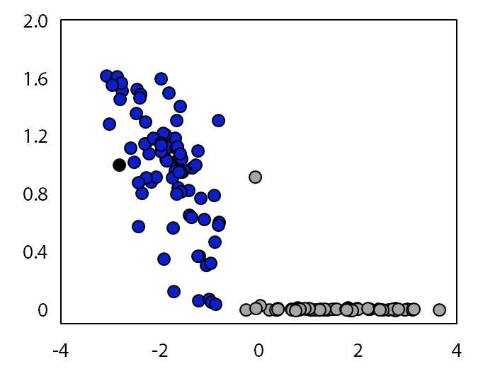
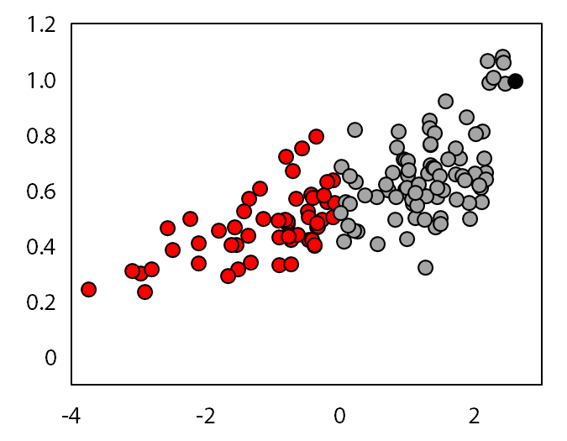
Yeast Display Binding
Predicted High Affinity
Predicted Low Affinity
Predicted High Specificity
Predicted Low Specificity
Antigen Binding
Ovalbumin Binding
ρ = -0.86
ρ = 0.69
Affinity Projection
Specificity Projection
Notes:
So here we have the correlation of the projection with real analog experimental data. The binding data is normalized to the parental mAb, shown in black. The spearman rank correlations are shown and are extremely high. And it’s very important to remember that all of this information, the affinity and specificity projections were distilled from just binary labels of primary sequence data. The correlation of both properties with analog data demonstrates the accuracy of the projections at predicting binding properties and suggested that co-optimization may be possible by plotting the projections against on another in what is known as pareto optimization.

Slide 17
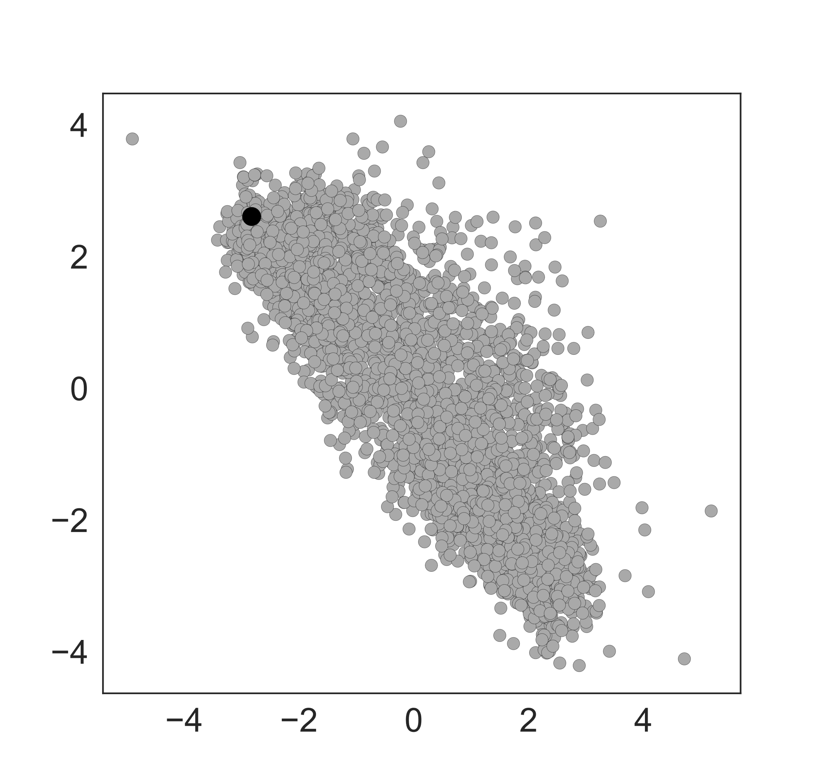
Pareto Optimization
Specificity Projection
Affinity Projection
Notes:
This is called a pareto optimization and here we have the specificity projection vs the affinity projection. To relate to real biophysical properties, as you go towards the origin, you optimize both.

Slide 18
Pareto Optimization
Increasing Specificity
Increasing Affinity
Notes:
Increasing specificity and affinity. If you map physicochemical properties onto this pareto blob you can begin to see determinants of binding just as described before.

Slide 19
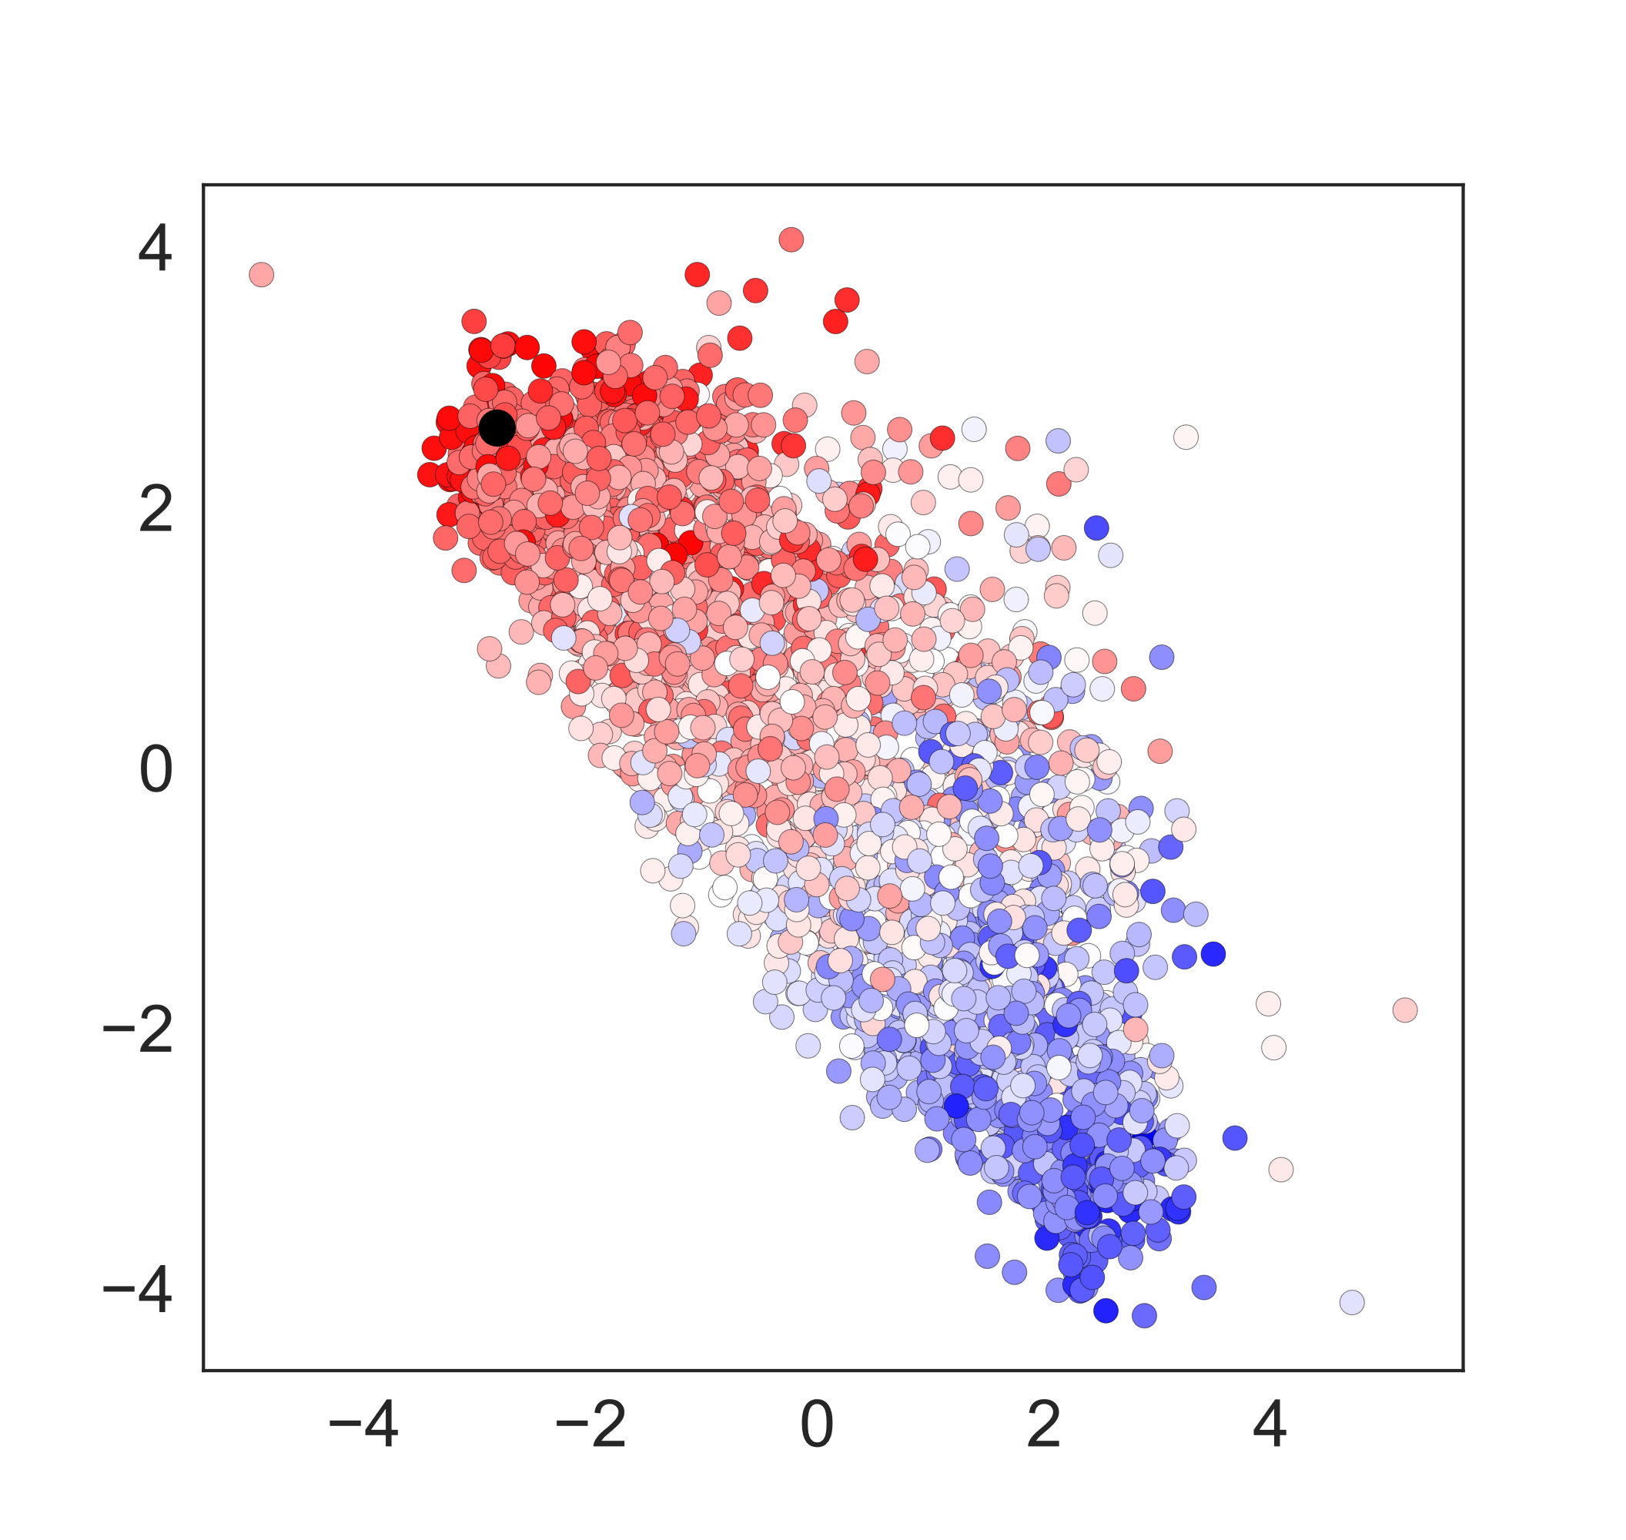
Pareto Optimization
Isoelectric Point
Increasing Specificity
Increasing Affinity
Notes:
If we investigate what physicochemical information may be distilled by UniRep we can begin to see trends. Coloring the sequences by the average isoelectric point of the library mutations you can see that reduced charge, blue, reduces interactions with both antigen and increase specificity.

Slide 20
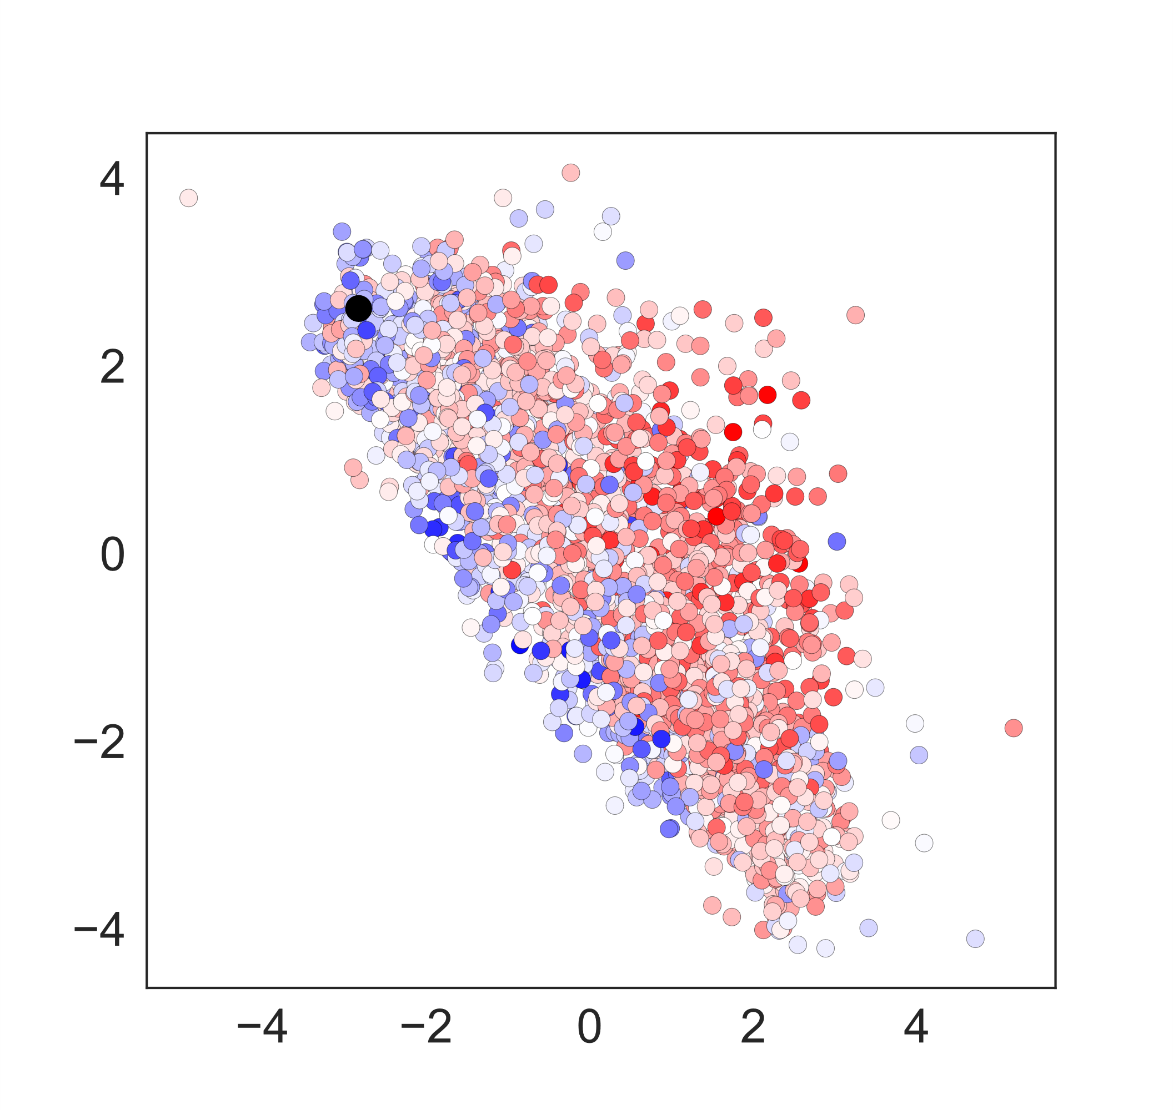
Pareto Optimization
Hydrophobic Moment
Increasing Specificity
Increasing Affinity
Notes:
Here we have the hydrophobic moment of the mutations introduced so as you increase the hydrophobicity, you decrease affinity but see less of a direct trend with specificity.

Slide 21
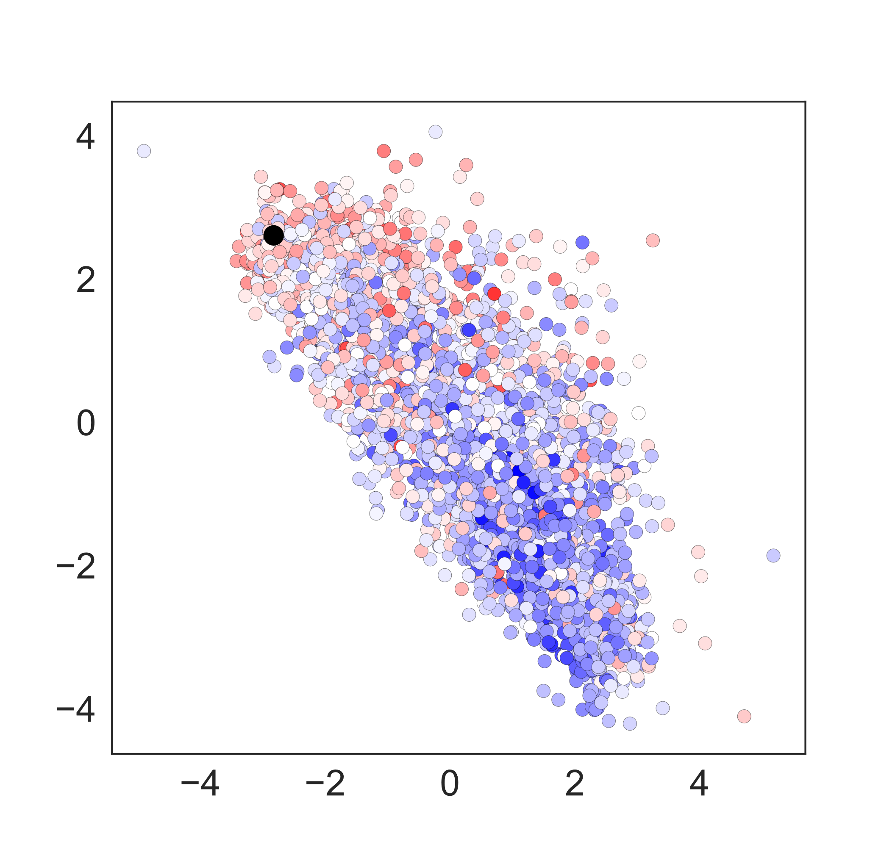
Pareto Optimization
Number of Side Chain Atoms
Increasing Specificity
Increasing Affinity
Notes:
If we investigate what physicochemical information may be distilled by UniRep we can begin to see trends. Coloring the sequences by the average isoelectric point of the library mutations you can see that reduced charge, blue, reduces interactions with both antigen and increase specificity.

Slide 22
Pareto Optimization
Increasing Specificity
Isolation of optimal clones
Controllable
Increasing Affinity
Notes:
With this pareto blob, we decided to try and isolate clones with specific improvements to binding properties exhibited and do so in a controllable manner that was unbound by the heuristics involved with the experimental acquisition of the sequence data nor typical assumptions made in antibody maturation.

Slide 23
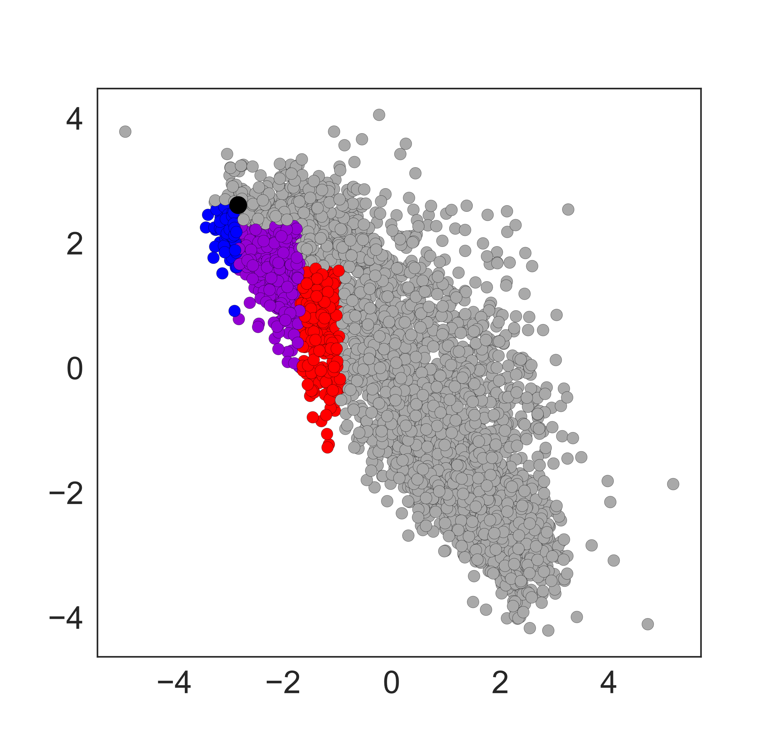
Pareto Optimization
Antigen focused
Maintain antigen binding while improving specificity
Balanced properties
Specificity focused
Improve specificity and sacrifice antigen binding
Increasing Specificity
Increasing Affinity
Notes:
For the isolation of clones, we chose three areas to focus on. In blue, this region prioritized antigen binding. Purple, balanced the properties. And red prioritized specificity.
Add slide where this pareto changes to have the 13 mAbs evaluated on it, colored

Slide 24
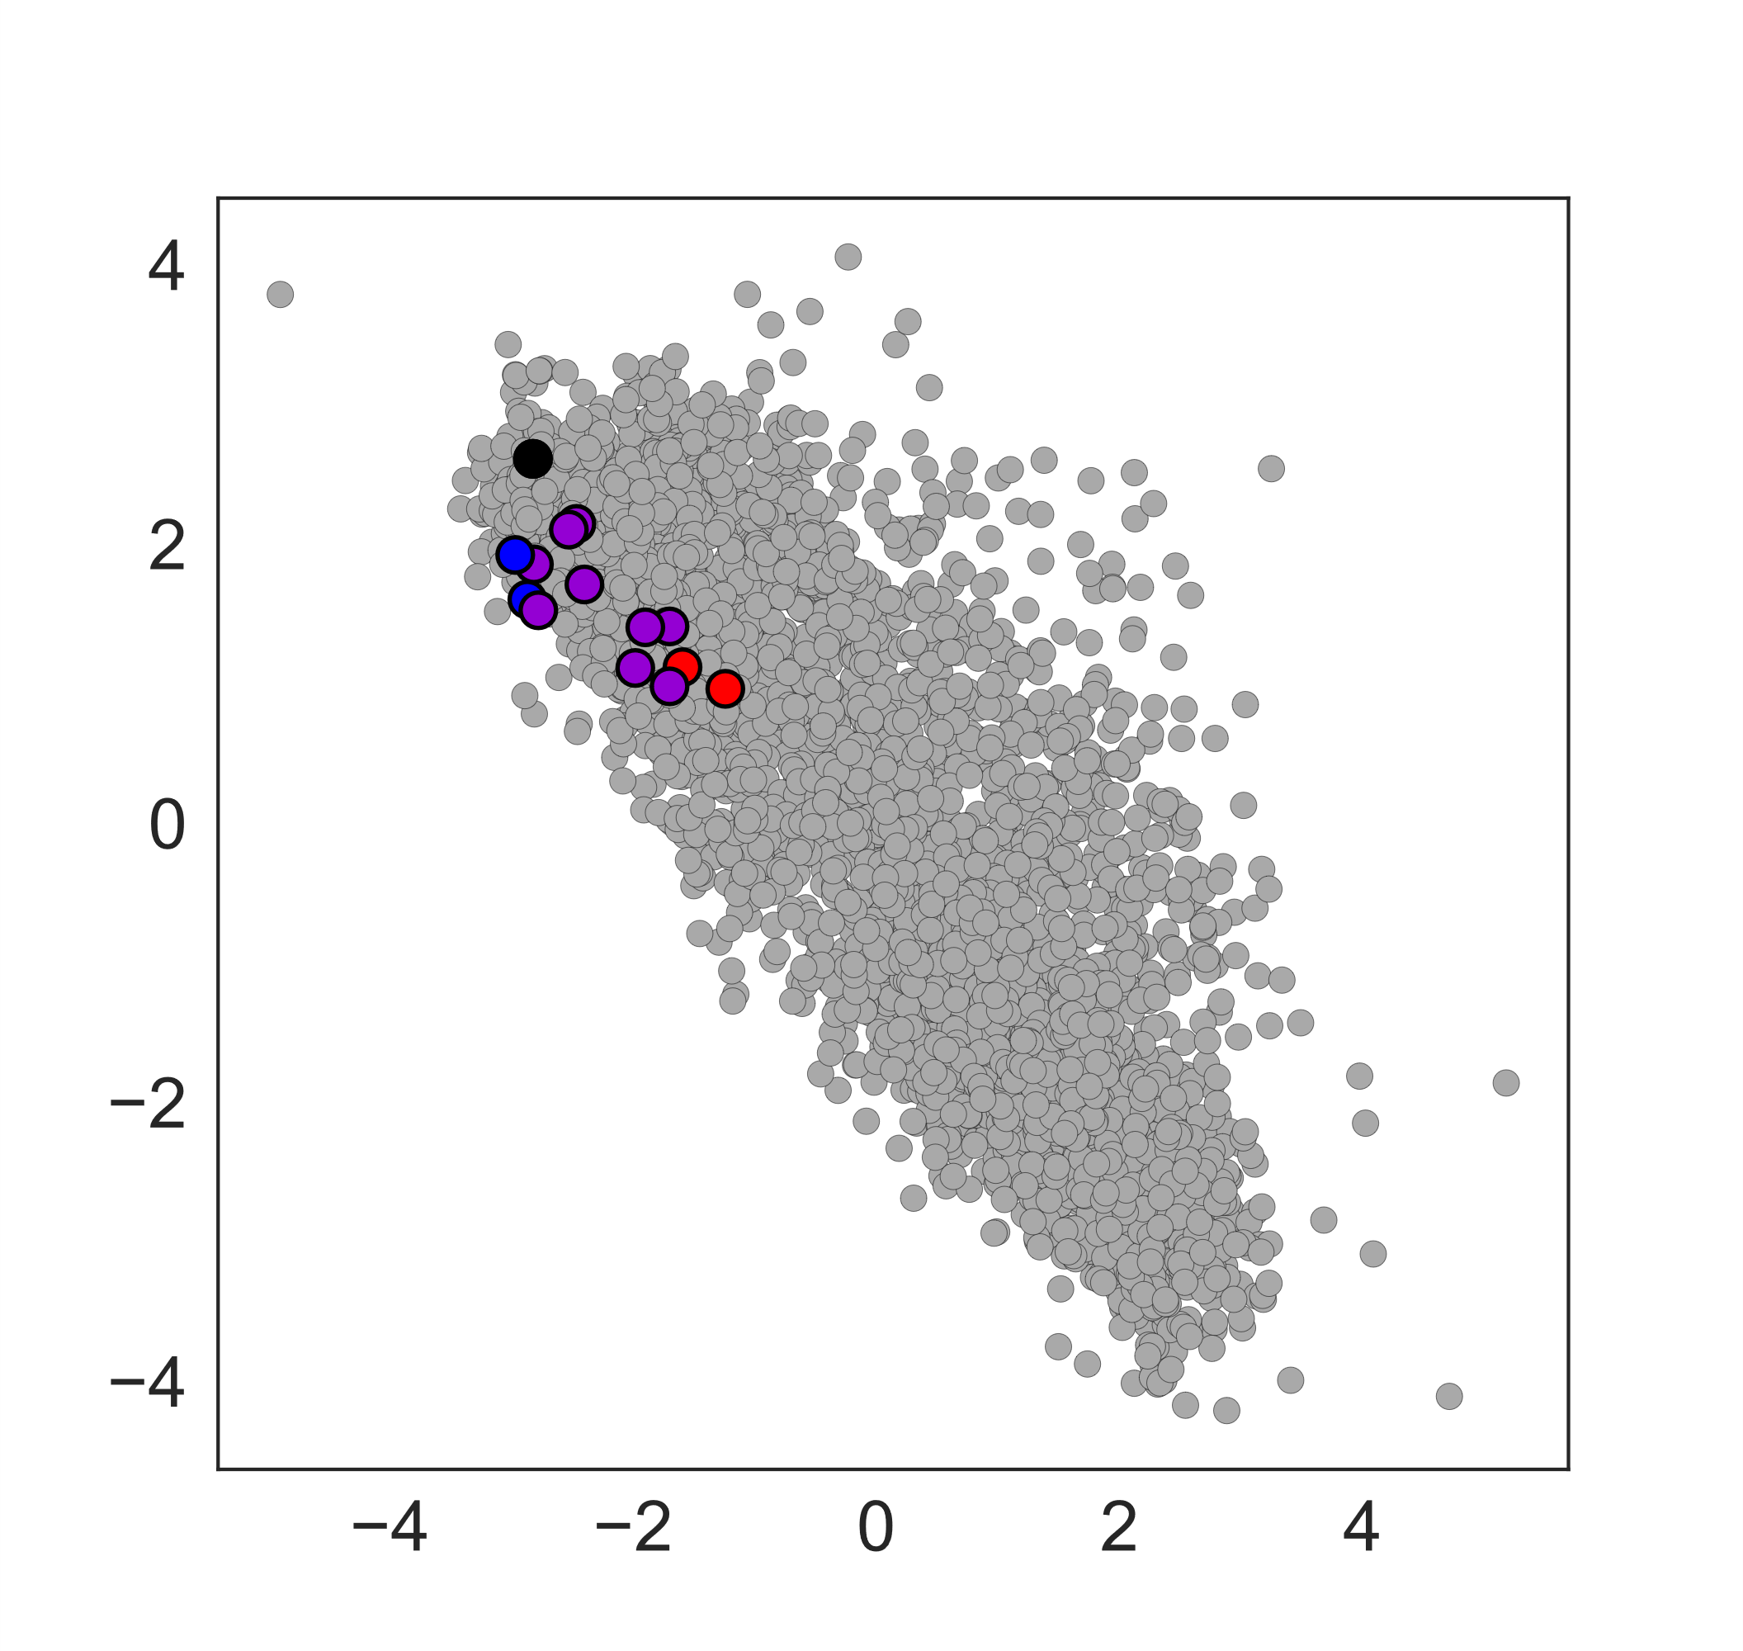
Pareto Optimization
Antigen focused
Maintain antigen binding while improving specificity
Balanced properties
Specificity focused
Improve specificity and sacrifice antigen binding
Increasing Specificity
Increasing Affinity
Notes:
For the isolation of clones, we chose three areas to focus on. In blue, this region prioritized antigen binding. Purple, balanced the properties. And red prioritized specificity.

Slide 25
Mutant Binding
Analyzed via novel bead-based binding assay
Immobilize antibody on beads
Incubate with reagent
- antigen
- ovalbumin
Fluorescently label and analyze via flow cytometry
Notes:
These soluble variants were evaluated with a bead-based binding assay I have developed that accurately assesses affinity and specificity via flow cytometry

Slide 26
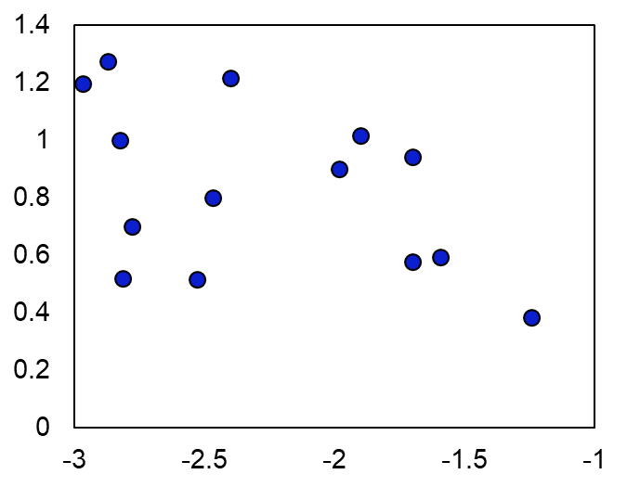
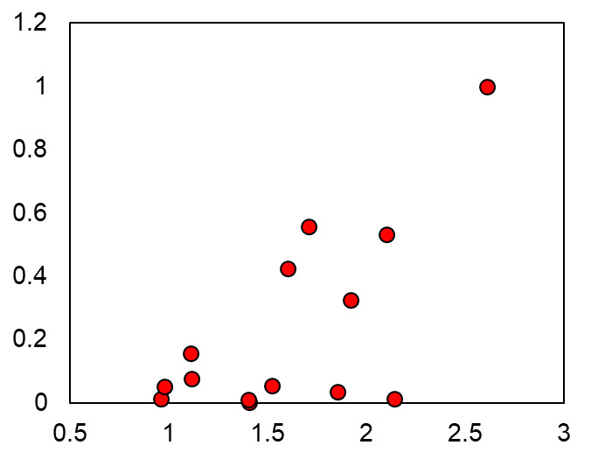
Soluble Antibody Binding
ρ = 0.44
Antigen Binding
Ovalbumin Binding
ρ = -0.44
Affinity Projection
Specificity Projection
Notes:
Here we have the soluble binding data. As you can see the correlation is worse than the yeast display data. However, reduced amount of data and the change of format from yeast-display to soluble IgG contribute significantly. However, this correlation is still extremely promising. It still allows for modestly accurate prediction of experimental binding data from primary sequence alone.

Slide 27
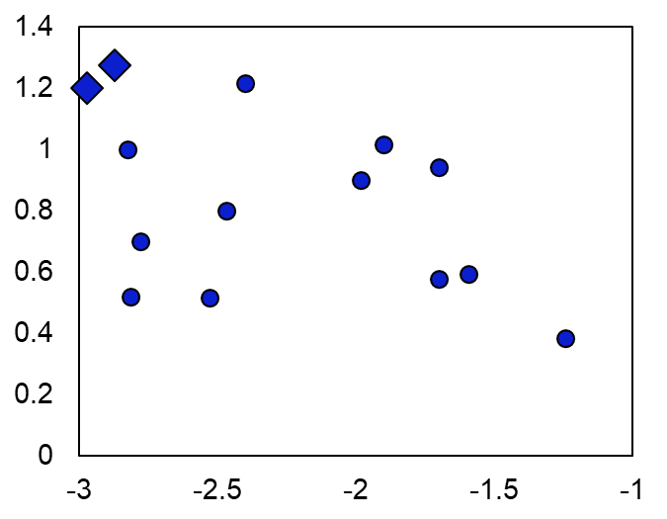
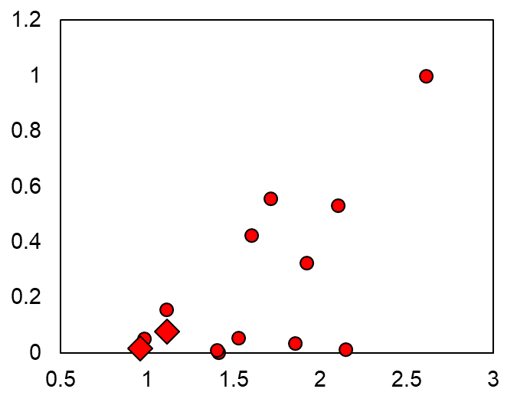
Soluble Antibody Binding
ρ = 0.44
Antigen Binding
Ovalbumin Binding
ρ = -0.44
Affinity Projection
Specificity Projection
Notes:
If you focus on the variants in the antigen focused group and the specificity focused group, you once again can see the property tradeoffs demonstrated.

Slide 28
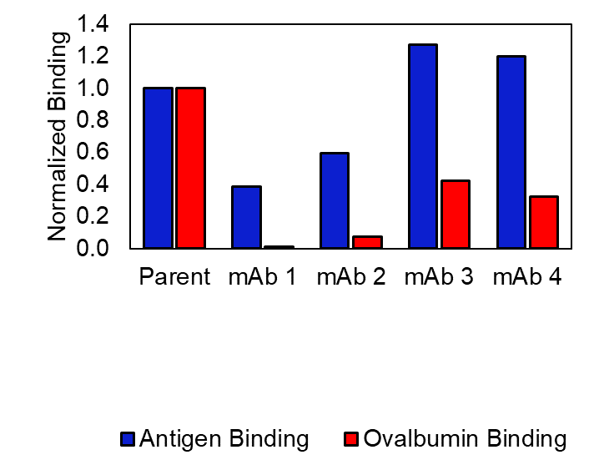
Soluble Antibody Binding
Further Improvements
Can the algorithm extrapolate to novel mutations?
Notes:
mAbs 1 and 2 are in the specificity focused group and while their ovalbumin (polyspecificity reagent) binding dramatically decreased, they lost some antigen binding. On the other hand, mAb 3 and mAb 4 were in the antigen focused group. Their affinity increased dramatically, yet their specificity did not increase as much.
So our next questions was how could we further improve these variants? Could we extrapolate outside of the sequence space explored and analyzed via the algorithm? We chose to take mAbs 3 and 4 with increased affinity and try and further improve their properties.

Slide 29
Virtual Screen
Create sequences with novel mutations based on scaffold mAbs 3 and 4
Extract features with UniRep
Project features onto single dimension
Predict optimal clones
Generalizability
Notes:
We did this with a virtual library screen. Created sequences with novel mutations sampling sites and residues not seen by the trained algorithm, extracted UniRep features, and predicted the optimal clones. This tests if the algorithm is generalizable. How broadly applicable is the information it’s learning or is it’s accuracy limited to the sequence space explored by the library and used to train the algorithm?

Slide 30
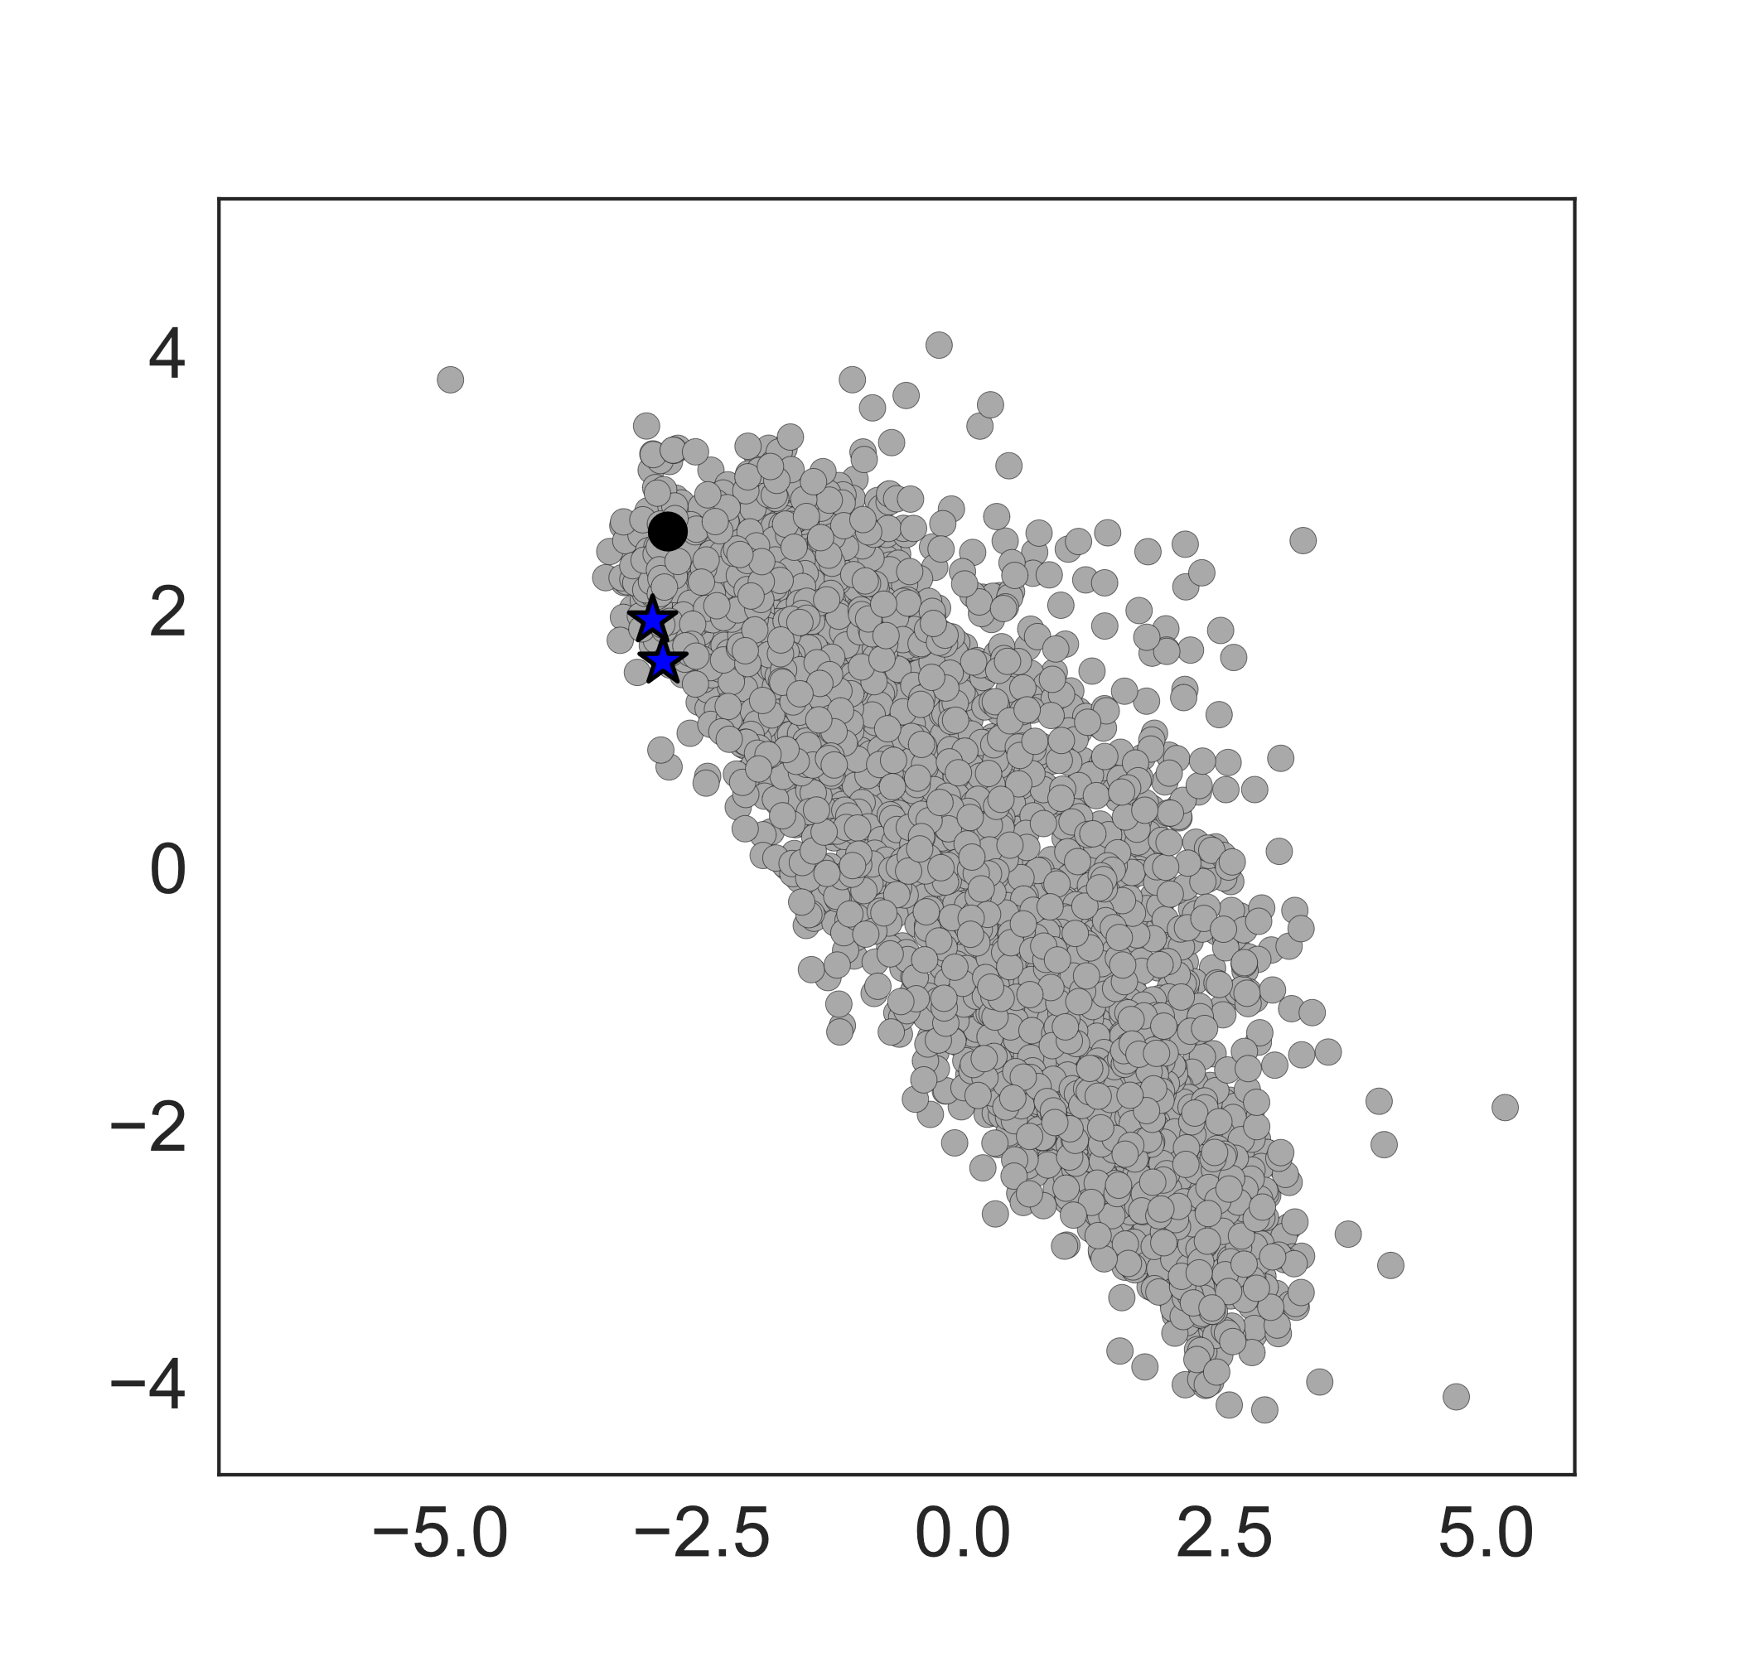
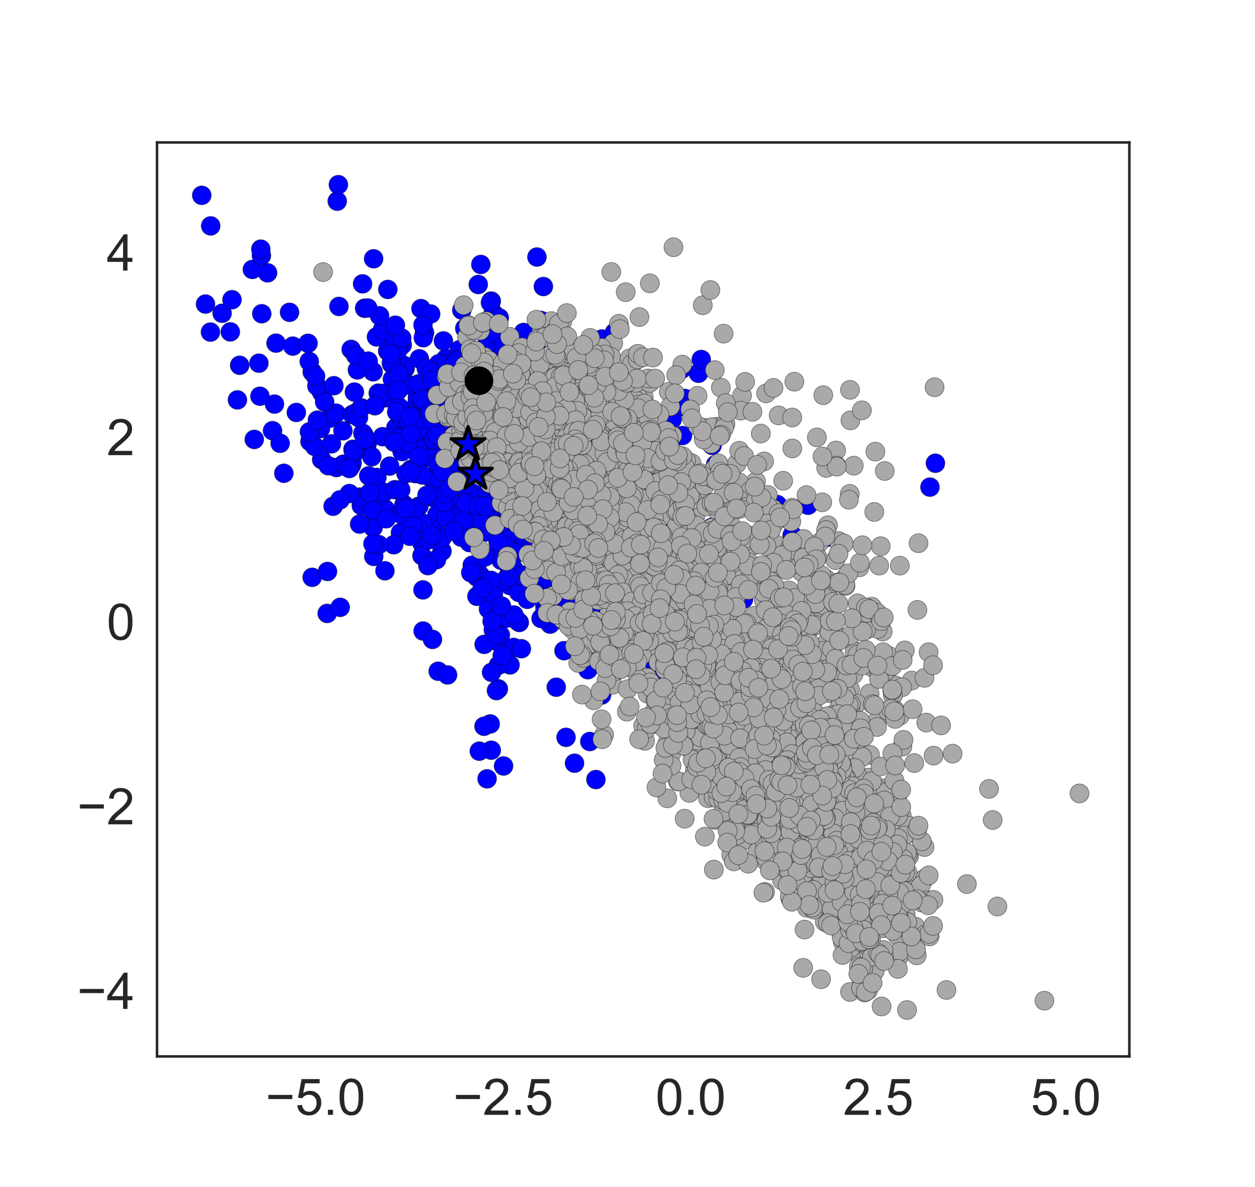
Virtual Screen
Increasing Specificity
Increasing Specificity
Increasing Affinity
Increasing Affinity
Notes:
Once again we have the pareto blob with the scaffold mAbs 3 and 4 sequence called out as blue stars. Now part of a pareto optimization is determining the pareto frontier. That frontier is the optimal combination of the two properties that is possible in the current analysis. Here the very obvious left-most edge is that frontier that demonstrates the tradeoff od affinity and specificity that cannot be further improved upon. This indicates that sequences in the library are not predicted to have better affinity or specificity combinations that these predictions. But once we add the results of the virtual screen we see something new. The blue point underlaid on the pareto blob are novel sequences and we can see that these cross that pareto frontier. So we took the novel pareto frontier and once again isolated three interesting regions.

Slide 31
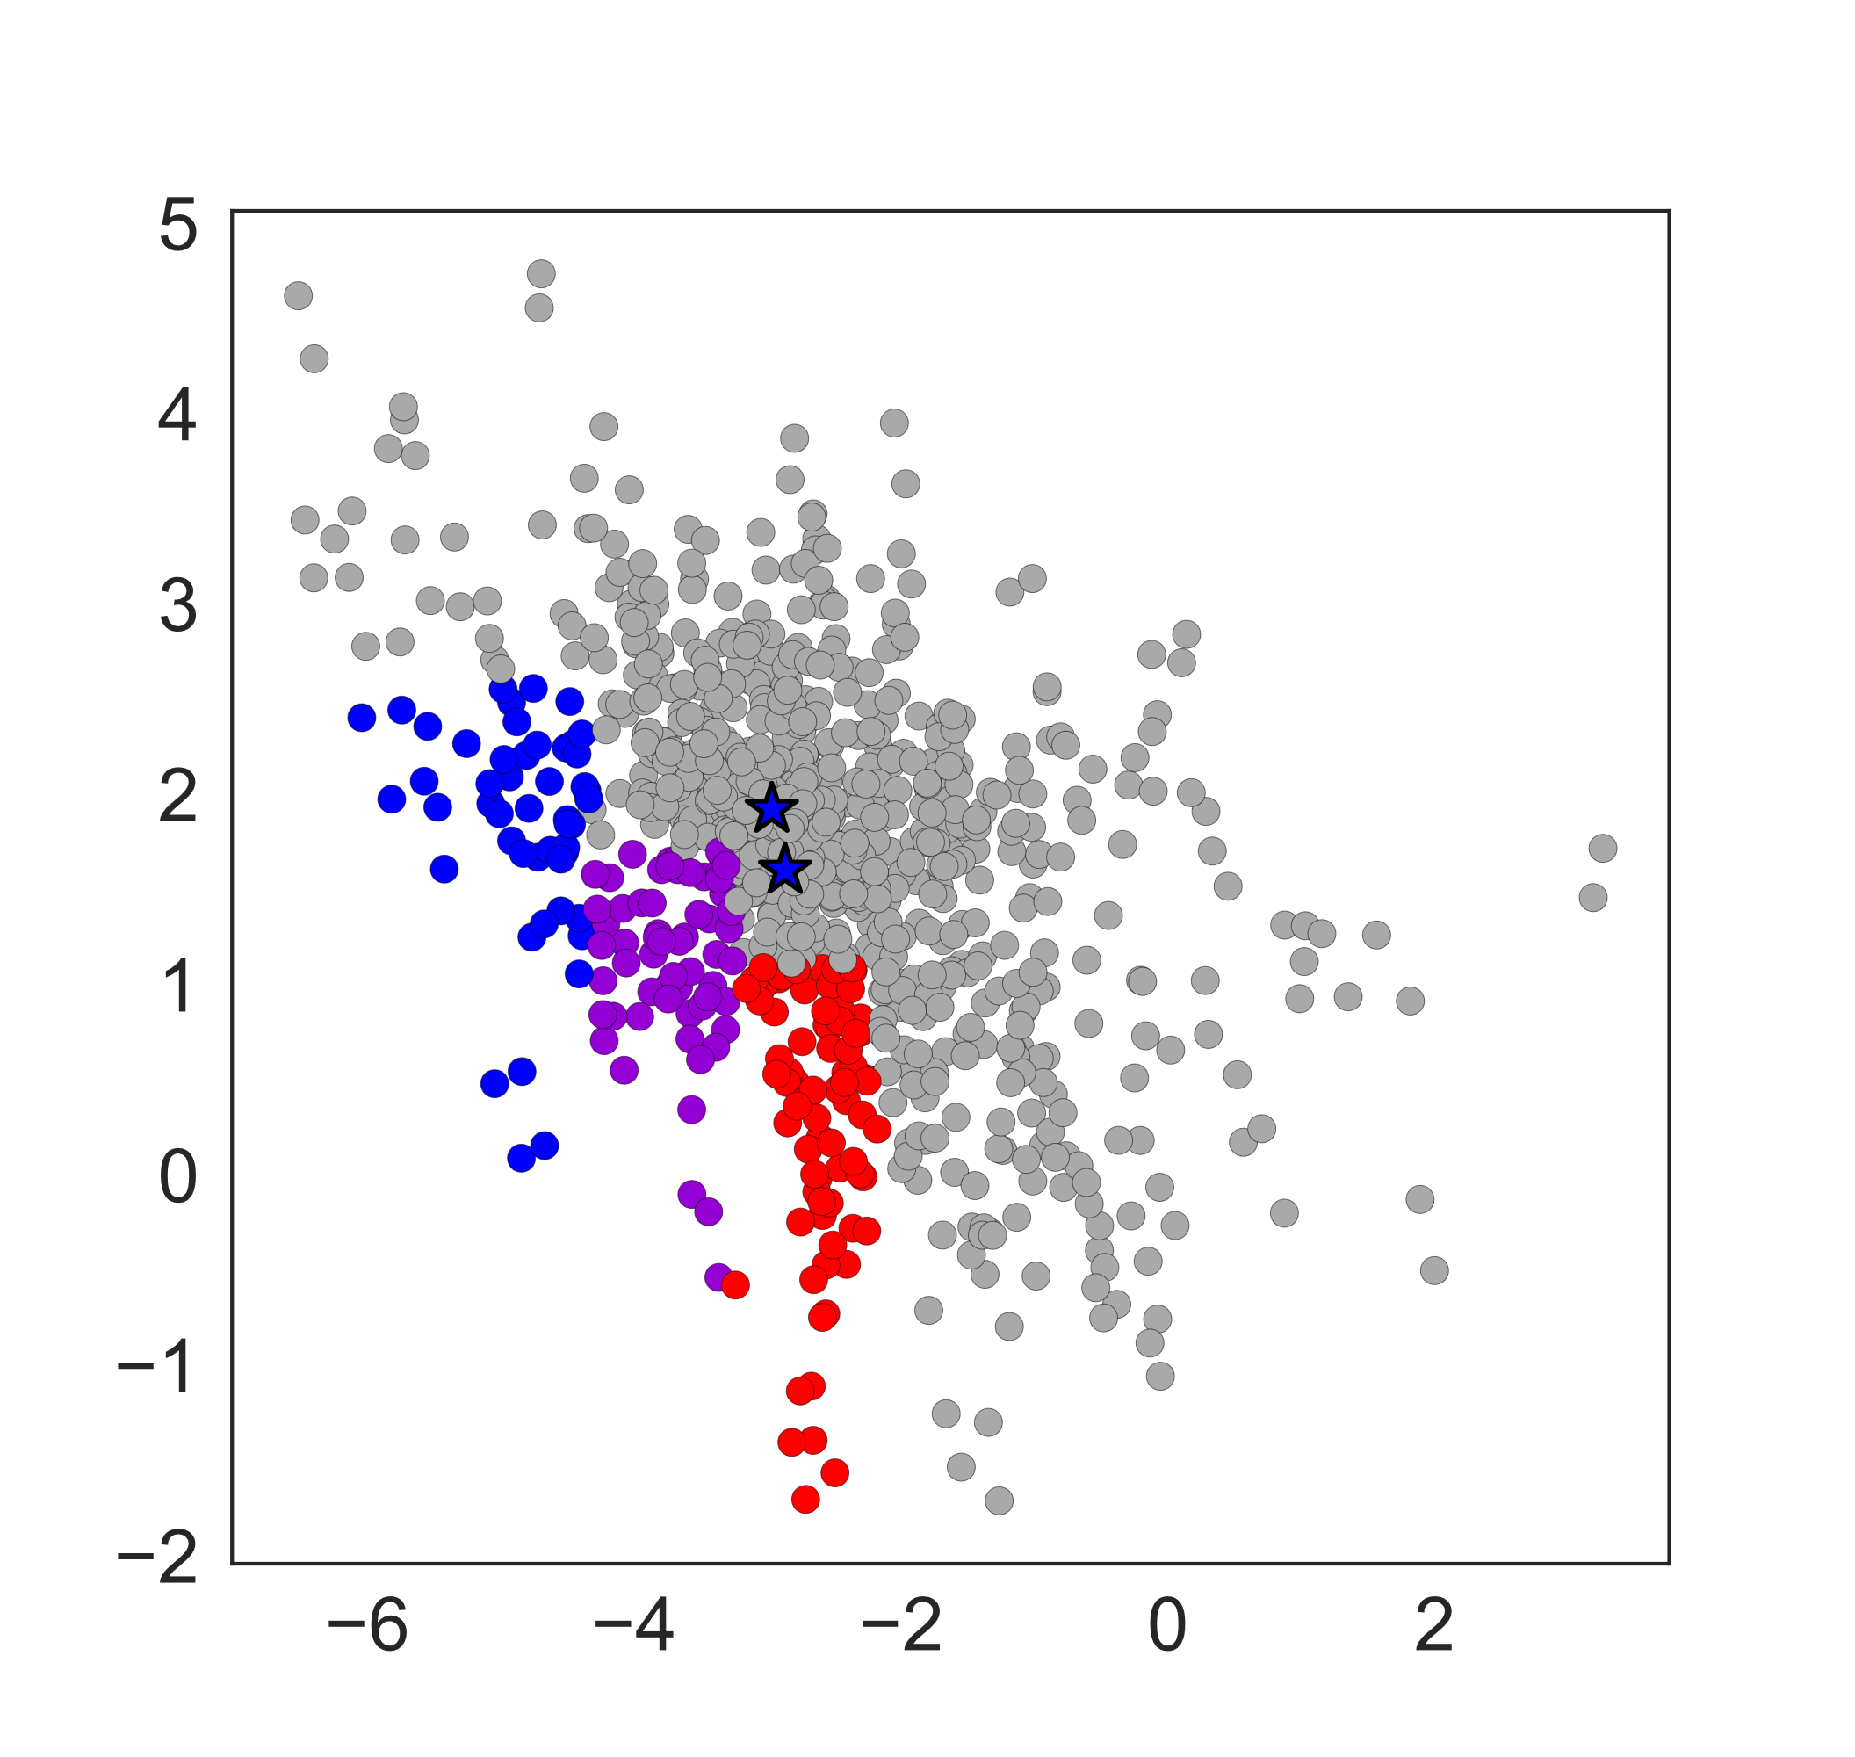
Virtual Screen
28 clones chosen:
Antigen focused
Balance properties
Specificity focused
Increasing Specificity
Increasing Affinity
Notes:
We isolated 28 sequences from these regions in total, produced and purified them as soluble antibodies for evaluation of the binding to antigen and ovalbumin. Now I’m not going to show the same correlation of the binding with the prediction, because there is no correlation. It’s completely random. However, the binding strengths, while the trends are not predicted accurately are still interesting in magnitude

Slide 32
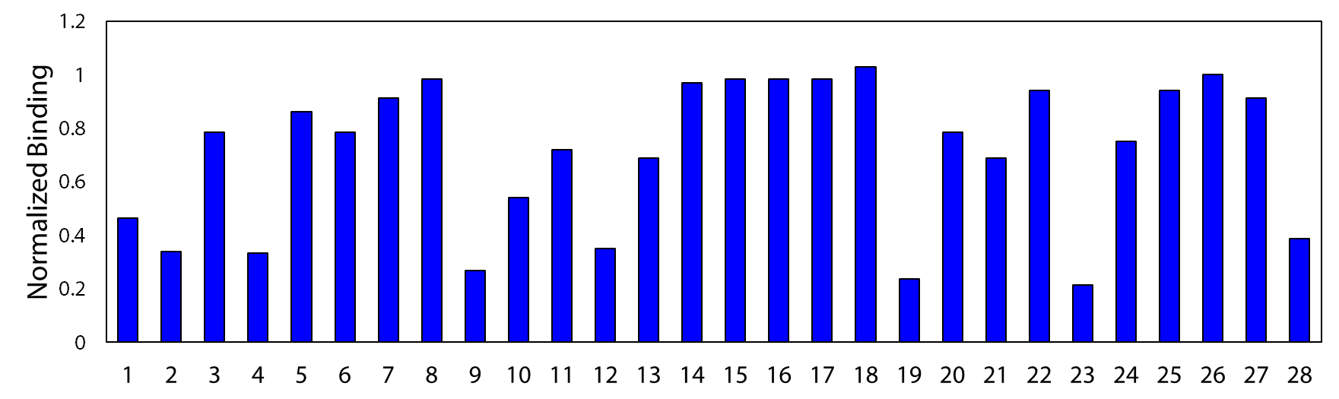
Affinity Measurements
Antigen Focused
Balanced Properties
Specificity Focused
Notes:
So here we have the affinity measurements, normalized to the scaffold that the novel mutation was introduced into. And you can see a lot of loss, interestingly mostly from the antigen focused group. However, while there is loss, there is also a lot of maintenance which is impressive. We also have one clone that improved its affinity from the scaffold. And I would like to point out that since these are normalized to the scaffold not the parental antibody, many have improved affinity relative the parental antibody we originally began with. So while not the exact results we were hoping for, still encouraging that the algorithm could predict non-detrimental mutations.

Slide 33
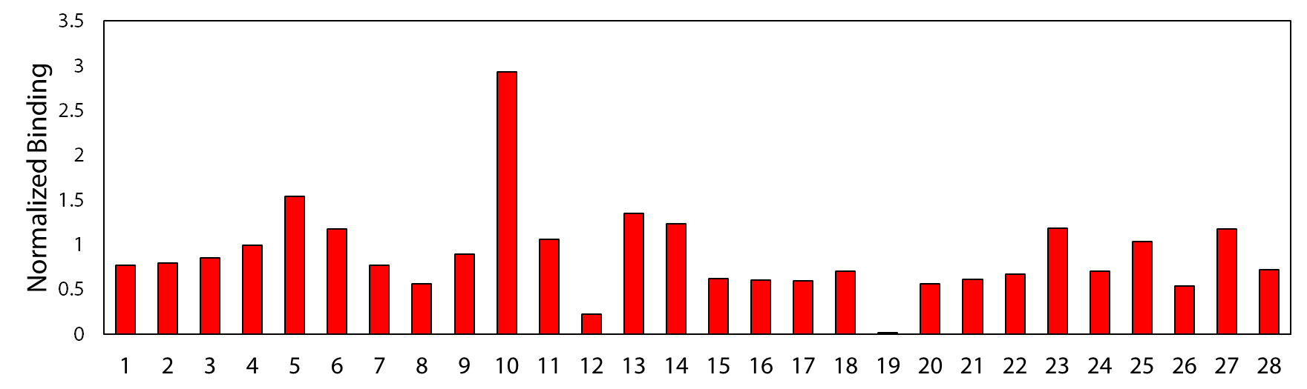
Specificity Measurements
Antigen Focused
Balanced Properties
Specificity Focused
Notes:
And here I’m showing the specificity measurements, the binding to ovalbumin. So once again here, high values are bad. The values are normalized to the scaffold ovalbumin binding values which were already greatly reduced from the parental antibody, so this is extremely encouraging and impressive that the algorithm could predict mutations that were further beneficial for specificity with about 75% accuracy. And for us, the contrast you see between affinity and specificity is also not that surprising. Affinity is a much for difficult property to predict with information that is applicable only to certain residues, or in this case, extrapolating from the mutations trained on to predict out-of-library mutations. Specificity is a more generalizable property, while we are still far from being able to apply concrete rules for improvement, it is more likely that the rules learned from in-library mutations, would extrapolate to out-of-library mutations. And with the success of the virtual screen, we were able to isolate 8 additional clones with high affinity and further improved specificity from the scaffold sequences in addition to the in-library sequences we could isolate.

Slide 34
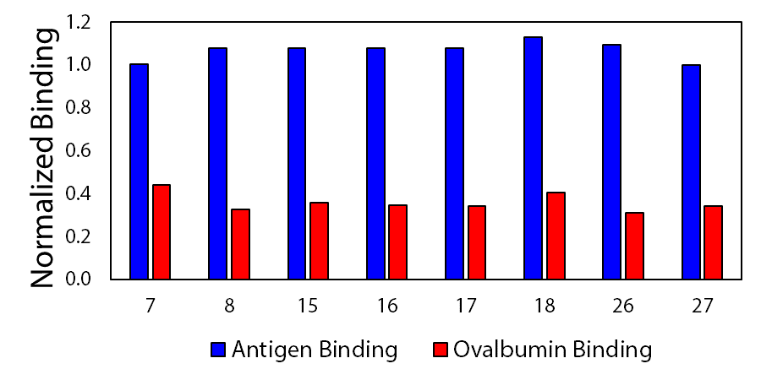
Successful Clones
Maintain at least 100% parental affinity
Increase Specificity by 50%
Notes:
These maintained at least 90 affinity of the parental and increase specificity by 50%. And once again this is combined with the beneficial in-library clones we isolated for an overall really robust method of antibody maturation that can effectively use the library you create and isolate the best clones from it and even is able to extrapolate to additional mutations for general properties such as specificity for additional improvements.

Slide 35
Summary
Properties
Affinity
Specificity
Features
Model
Notes:
Overall, what I accomplished is the validation of a recurrent neural network as a feature extraction method for the prediction of antibody binding properties from primary sequence data alone. This is extremely important and powerful conclusions that will facilitate more efficient and effective drug development and optimization

Slide 36
Future Work
Iterative design process for affinity optimization
Discovery platform: increase diversity analyzed
Library generation
Train algorithm
Analyze algorithm
Predict new library mutations
Naïve library
Parental antibody library
Optimal antibody
Diversity
Notes:
For future work I’d like to start analyzing the neural network more in depth to see if I can use information gleamed from neural attention or architecture analysis to inform the design of a second library which would then train a second algorithm for tunable optimization of more difficult properties such as affinity

Slide 37
Acknowledgements
Tessier Lab
Prof Craig Streu
Dr. Jie Huang
Dr. John Schardt
Dr. Wenjia Lou
Dr. Hongwei Chen
Alec Desai
Yulei Zhang
Linderman Lab
Patrick Kinnunen
Meu Pornnappadol
Harkamal Jhajj
Lina Wu
Matt Smith
Zennifer Zupancic
Manali Sawant
Timothy Rodgers

